Slide 1
Objectives
In this session, you will learn to:
Define rendering
Identify the need for style sheets
Create a cascading style sheet
Create an XSLT for formatting data

Slide 2
Rendering XML documents
Rendering refers to the act of processing an XML document so that it can be displayed on a variety of targets, such as Web browsers, e-mail, pagers, and cellular phones.
Style Sheets
A style sheet is a document that contains formatting rules for one or more XML documents.
It contains the code to instruct the Web browser on how to translate the structure of the source document into a structure that can be displayed.

Slide 3
What does a Style Sheet Allow you to do?
A style sheet allows you to perform the following tasks:
  Transform an XML document into another structure for the purpose of rendering it to a specific target. This may include:
    Generating constant text, such as labels and headings
    Specifying filters for extracting the required data
    Changing the sequence of elements and attributes
    Sorting the content
    Performing complex transformations that compute values based on the existing content

Slide 4
What does a Style Sheet Allow you to do? (Contd.)
  Describe how to present the transformed information. Description of presentation includes:
    Screen or page layout
    Assignment of transformed content into lists and paragraphs
    Specification of properties such as spacing, margins, alignment, and fonts

Slide 5
Problem Statement 5.D.1
CyberShoppe wants to display the details of all the products that it sells. The product details need to be displayed in a browser in the format specified below:
  The price per unit, description, and quantity on hand for each product should be displayed in teal color with a font size of 10 pts.
  The name of the product must be displayed in red with a font size of 20 pts. It should be displayed in bold.
  All details must be displayed in the Arial font.

Slide 6
Task List
Identify the elements to be displayed.
Identify a mechanism to display formatted data.
Create a style sheet to format data.
Apply the style sheet to the XML document.
View the document in a browser.

Slide 7
Task 1:Identify the elements to be displayed.
Result
As per the given scenario, the elements that have to be displayed are:
  PRODUCTNAME
  PRICE
  DESCRIPTION
  QUANTITY

Slide 8
Task 2:Identify a mechanism to display formatted
data.
Cascading Style Sheets (CSS)
  A Cascading Style Sheet (CSS) is a type of style sheet that provides a simple mechanism for adding styles to an XML or HTML document.
  A CSS is a text file containing one or more rules or definitions for the style characteristics of a particular element.
  The CSS file can be included in a number of XML documents that have the same data structure.

Slide 9
Task 2:Identify a mechanism to display formatted
data. (Contd.)
Result
  As CSS allows you to format data in an XML document, CSS can be used to display the products data stored in the XML document in the specified format.

Slide 10
Task 3:Create a style sheet to format data.
CSS allows you to format the contents of a document by specifying the element name followed by the formatting instructions for that element. The syntax for coding a CSS is as follows:
elementname
{
property1: value;
property2: value;
property3: value;
}

Slide 11
Task 3:Create a style sheet to format data. (Contd.)
Action
Type the code for creating the style sheet and save the file as product.css.

Slide 12
Task 4:Apply the style sheet to the XML
document.
In order to apply the formatting specifications given in the CSS file to the data in an XML document, you need to associate the CSS with the XML document.
This can be done using the following syntax:
  <?xml:stylesheet type="text/css" href="path-name"?>

Slide 13
Task 5:View the document in a browser.

Slide 14
Just a Minute…
The details about all the books sold at CyberShoppe are to be displayed in the following format:
  The book name is to be displayed in blue, Times New Roman, size 20pts, and bold.
  The first name and last name of the author are to be displayed in green, Arial, and size 10pts.
  Price of the book is to be displayed in red, Times New Roman, and size 20pts.
Create a CSS for displaying the book details in the above format.

Slide 15
Problem Statement 5.D.2
CyberShoppe needs to display product details, such as product ID, name of the product, and price per unit.
In the output, all details about products should be displayed in red.

Slide 16
Task List
Identify the data to be displayed.
Identify a mechanism for displaying selective data in a sorted order.
Identify the elements required to display selective data in a sorted order.
Create a style sheet.
Apply the style sheet to the XML document.
View the XML document.

Slide 17
Task 1:Identify the data to be displayed.
Result
As per the given scenario, the data that is to be displayed is as follows:
  PRODID
  PRODUCTNAME
  PRICE

Slide 18
Task 2:Identify a mechanism for displaying
selective data in a sorted order.
CSS does not support operations, such as reordering and sorting elements based on a condition, and displaying only selective elements.
To help you perform such operations, XML supports another style sheet language called eXtensible Style Sheet Language (XSL).
XSL is made up of the following parts:
  XSL Transformations (XSLT): It is an XML-based language that allows you to transform an XML document into another XML document.

Slide 19
Task 2:Identify a mechanism for…(Contd.)
  XML Path (XPath): It is a language that is used to access different parts of an XML document, such as elements and attributes.
XSL uses XSLT to transform an XML document that contains data.
XSLT contains instructions for specifying how an XML document is to be transformed.
XSLT uses XPath expressions to extract specific data from an XML document.

Slide 20
Task 2:Identify a mechanism for…(Contd.)
A software called XSLT processor reads the instructions given in XSLT and transforms the XML document into another XML document, which uses formatting objects of XSL to display the XML document in the desired format.

Slide 21
Task 2:Identify a mechanism for…(Contd.)
Comparison between XSLT and CSS
XSLT is a superset of the CSS functionality.
XSLT is an application of XML. Therefore, it follows the XML syntax, whereas CSS has its own syntax. XML and CSS can co-exist since they meet different needs.
XSLT is intended for complex formatting.

Slide 22
Task 2:Identify a mechanism for…(Contd.)
Working of the XSLT Processor
MSXML Parser
XSLT style sheet
XSLT tree
XSLT processor
Result tree
XML document
Source tree

Slide 23
Task 2:Identify a mechanism for…(Contd.)
Result
Since XSL gives you added functionality of extracting specific data from an XML document, XSL can be used to select data as per the scenario.
You need to use XSLT, which is a part of XSL, to create a style sheet. This style sheet should contain the instructions for transformation of an XML document into the result tree.

Slide 24
Task 3:Identify the elements required to display
selective data in a sorted order.
XSLT provides a number of elements for selecting and formatting data.
Some of the XSLT elements are:
  stylesheet
  value-of
  for-each
  sort
  text

Slide 25
Task 3:Identify the…sorted order. (Contd.)
The stylesheet element
  Since an XSLT style sheet contains instructions for transforming XML documents, a declaration is added in the XSLT file to instruct the browser that it is a style sheet file. This declaration is known as style sheet declaration.
  The syntax for style sheet declaration is as follows:
<xsl:stylesheet xmlns:xsl="http://www.w3.org/1999/XSLTransform" version=”1.0”>

Slide 26
Task 3:Identify the…sorted order. (Contd.)
The value-of element
  This element displays the value of the element or attribute specified. The syntax for using this element is as follows:
  <xsl:value-of select="elementname|attributename" />
  If you want to display the value of an attribute, you must use the “@” symbol as a prefix with the attribute name.

Slide 27
Task 3:Identify the…sorted order. (Contd.)
The for-each element
  This element is used to instruct the XSLT processor to process the information for each instance of the specified pattern.
  The syntax for using the for-each element is as follows:
  <xsl:for-each select="pattern">
  [action to be performed]
  </xsl:for-each>

Slide 28
Task 3:Identify the…sorted order. (Contd.)
The for-each element (Contd.)
  The select attribute of the for-each element allows you to specify the elements or attributes on which the action needs to be performed.
  The XSLT transformation instructions within the for-each element are applied to each of the nodes selected by the select attribute of the for-each element.

Slide 29
Task 3:Identify the…sorted order. (Contd.)
The sort element
  XSLT provides the sort element for sorting data based on values assigned to elements and attributes.
  The sort element does not contain any child elements.
  This element is always used as a child of the for-each element or the apply-templates element.

Slide 30
Task 3:Identify the…sorted order. (Contd.)
The sort element (Contd.)
  The syntax for using the sort element is as follows:
  <xsl:sort select="expression" order="ascending|descending"
  case-order="upper-first|lower-first“
  data-type="text|number|qname"/>

Slide 31
Task 3:Identify the…sorted order. (Contd.)
The text element
  The text element allows you to generate constant text in the output.
  This element can be used to display labels.

Slide 32
XSLT Template Rules
XSLT allows you to define template rules for the output.
A template rule describes how an XML element and its contents are converted into a format that can be displayed in the browser.
A template rule consists of two parts:
    A pattern that identifies an XML element in an XML document.
    An action or processing code that details the transformation and rendering of the resulting element.

Slide 33
XSLT Template Rules (Contd.)
XSLT uses two main elements for creating template rules, template and apply-templates.
The template Element
  The template element is used to define a template for the desired output. The syntax for using this element is as follows:
  <xsl:template match="pattern">
  [action to be taken]
  </xsl:template>

Slide 34
XSLT Template Rules (Contd.)
The apply-templates Element
  This element is used to instruct the XSLT processor to find an appropriate template and perform the specified tasks on each selected element.
  The syntax for using this element is as follows:
  <xsl:apply-templates [select="pattern"]>
  The select attribute is optional and is used to specify the context in which the template should be executed.

Slide 35
XSLT Template Rules (Contd.)
The apply-templates Element (Contd.)
  You can effectively use templates in order to display data.
  The XSLT processor always starts processing from the root element. Therefore, it starts processing from the template rule <xsl:template match=“/”>.
  If you have more than one template rule created for the same element, the previous template rule will be overridden by the other template.

Slide 36
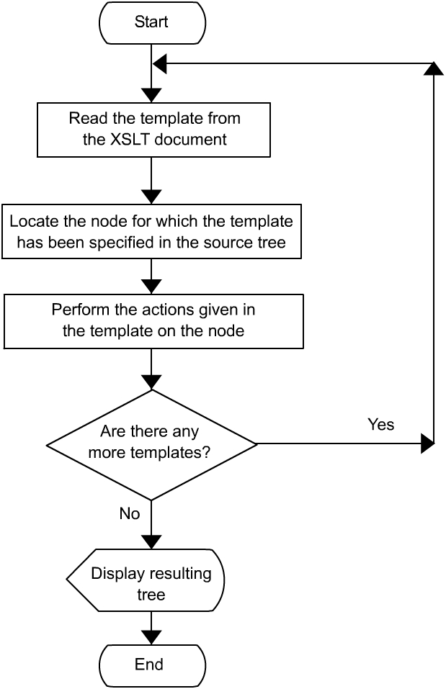
XSLT Template Rules (Contd.)

Slide 37
XSLT Template Rules (Contd.)
Default Template
To prevent the processing of templates from stalling when there is no suitable selection rule, the XSLT processor assumes a default template rule.

Slide 38
XSLT Template Rules (Contd.)
Default Template (Contd.)
The default template rule consists of the following statements:
  <xsl:template match= "/">
  <xsl:apply-templates/>
  </xsl:template>
  <xsl:template match="*">
  <xsl:apply-templates />
  </xsl:template>
  <xsl:template match="text()">
  <xsl:value-of select=".">
  </xsl:template>

Slide 39
Task 3:Identify the…sorted order. (Contd.)
Result
The following XSLT elements are used to extract and format the required data:
  stylesheet: To specify the style sheet declaration.
  for-each: To display the product ID, product name, and price for each instance of the product element.
  value-of: To display the values of PRODID, PRODUCTNAME, and PRICE.
  sort: To sort the elements and attributes containing product details based on the product ID.
  text: To display the labels for various elements and attributes.
  template: To be used as the parent element of the for-each element.

Slide 40
Task 4:Create a style sheet.
Action
As per the scenario, the product details, such as PRODUCTID, PRODUCTNAME, and PRICE have to be sorted in the ascending order of the PRODID attribute.
To do this, type the necessary code as save the file as product1.xsl.

Slide 41
Task 5:Apply the style sheet to the XML
document.
To view selective details of a product, such as product ID, name, and rate from an XML document, you need to associate the XML document with the XSL file that renders the required data.
This can be done using the following syntax:
  <?xml:stylesheet type="text/xsl" href="path-name"?>
Action
Type the code for creating the XML document as save the file as product.xml.

Slide 42
Task 6:View the XML document.

Slide 43
Problem Statement 5.P.1
CyberShoppe wants to display the details of all books to its customers. The book details that have to be displayed are book ID, title, and rate of books. The book details must be displayed in the ascending order of rate and book ID.

Slide 44
Summary
In this lesson you learned that:
Rendering is the process of presenting the data in an XML document in different formats.
A style sheet is a separate document that contains the formatting rules for one or several XML documents.
There are two types of style sheets used with XML documents. They are:
  Cascading Style Sheets (CSS)
  eXtensible Stylesheet Language (XSL)

Slide 45
Summary (Contd.)
CSS is used to define the style or appearance of an XML document.
XSL is made up of XSL Transformations (XSLT) and XML Path (XPath).
XSLT is a superset of the CSS functionality.
XSLT is used to display selective elements or attributes, sort data on one or more elements, and process the data on the basis of a condition.
XSLT elements, such as template, apply-templates, sort, for-each, and value-of are used to extract and format data.

Slide 46
Summary (Contd.)
An XSLT style sheet contains a set of templates rules. A template rule describes how an XML element and its contents are converted into a format that can be displayed in the browser.
Each template rule has two parts: a pattern and an action.
The reference to a style sheet file is included in an XML document by using the syntax
<?xml:stylsheet type="text/css or xsl" href="path-name"?>

